Slide 1
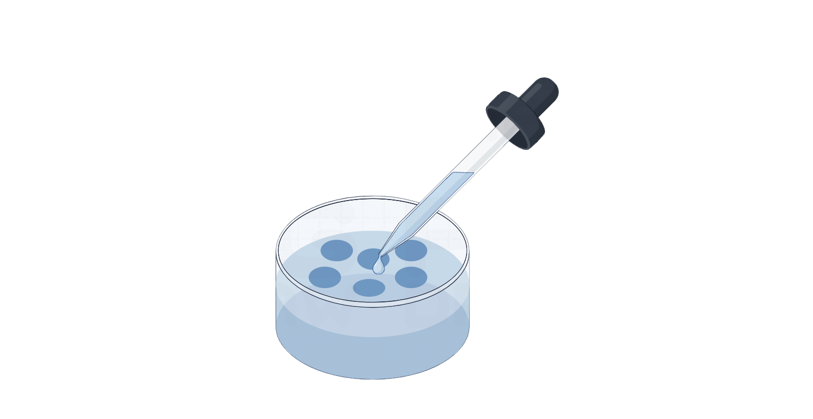
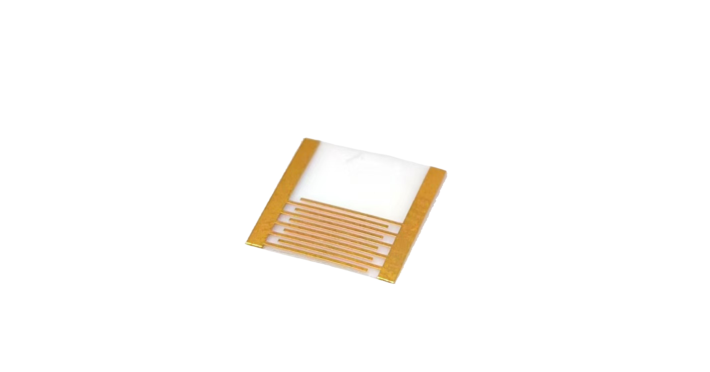
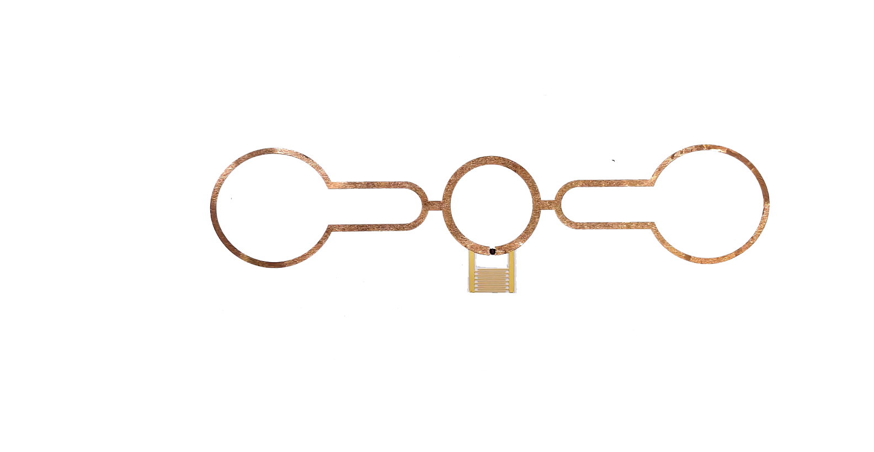
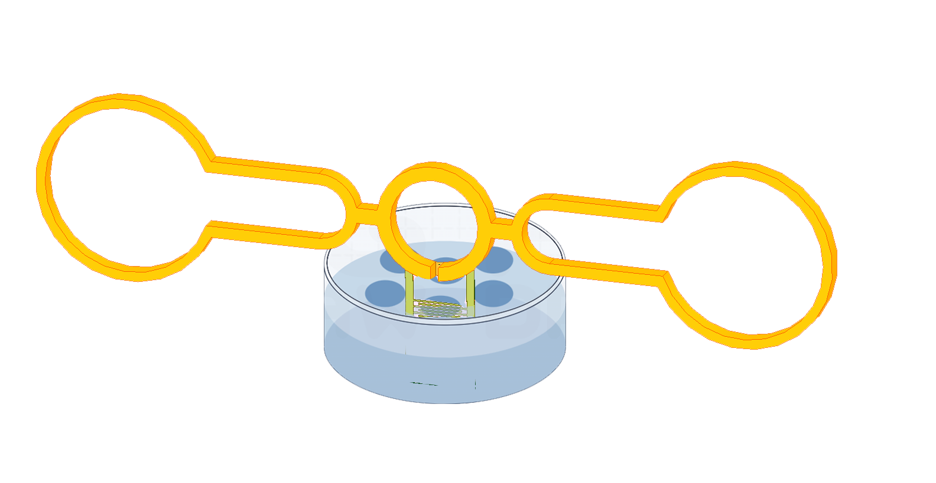
(a)
Interdigitated Structure
Bovine bone protein solution
Liquid
probe
Interdigitated gold-plate electrodes
(b)
Immerse the probe into the solution

Slide 2
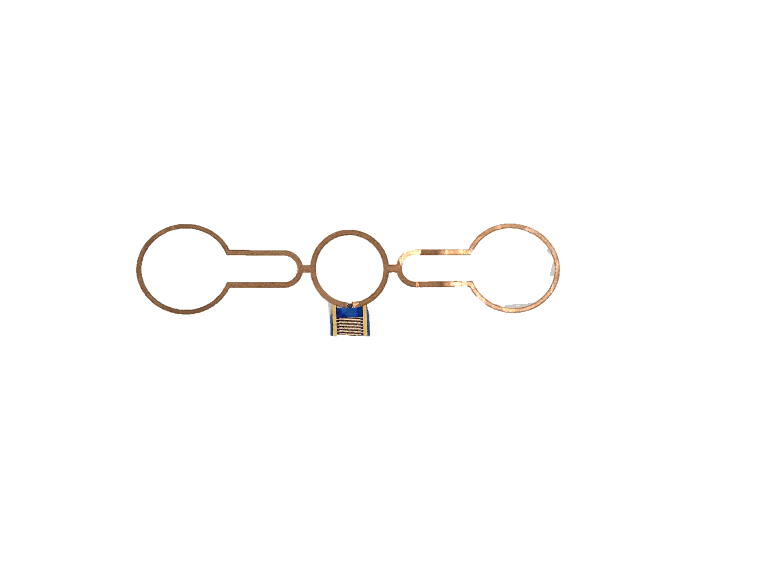
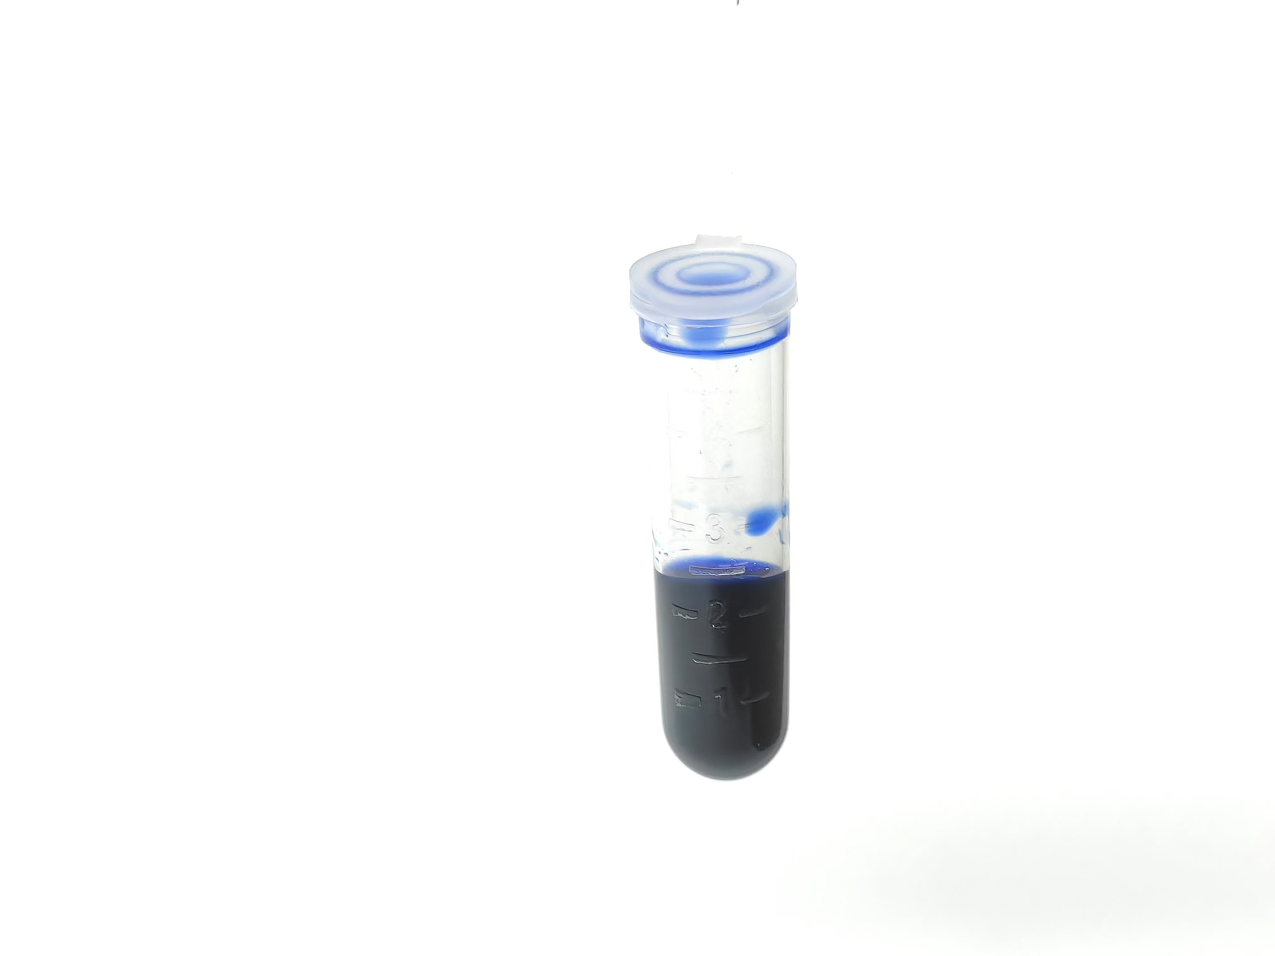
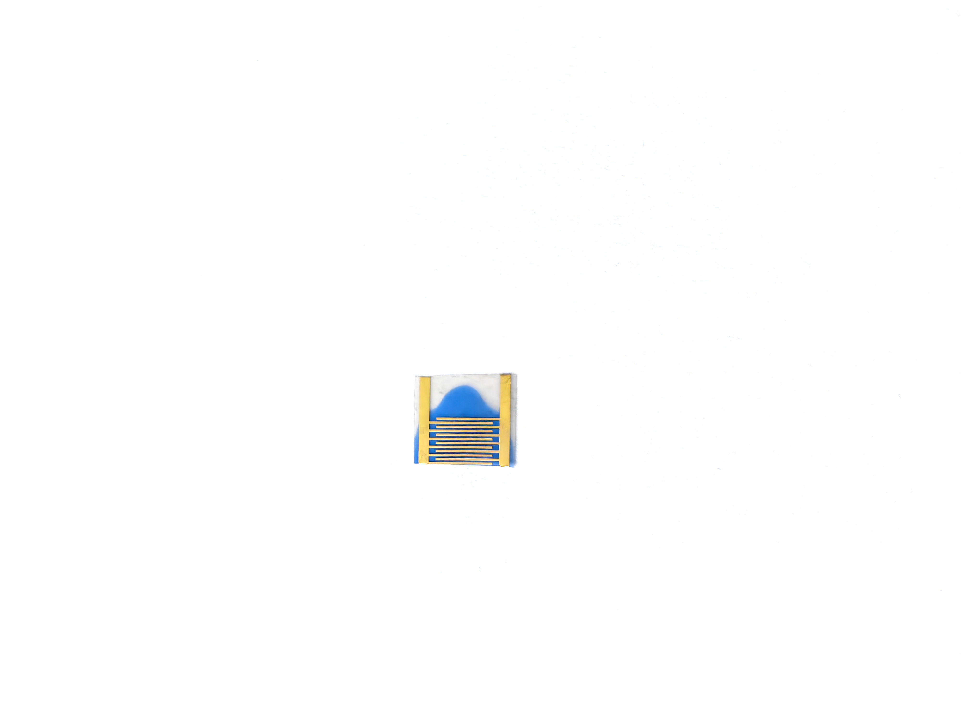

Slide 3
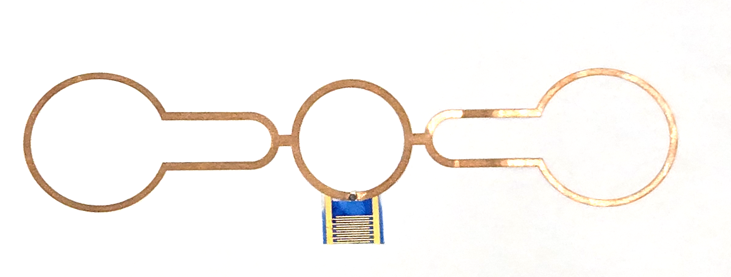
PhB/PVC
composite film
PET
Interdigitated capacitor
5mm
PhB/PVC
Solution
P-PhB/PVC Sensor

Slide 4
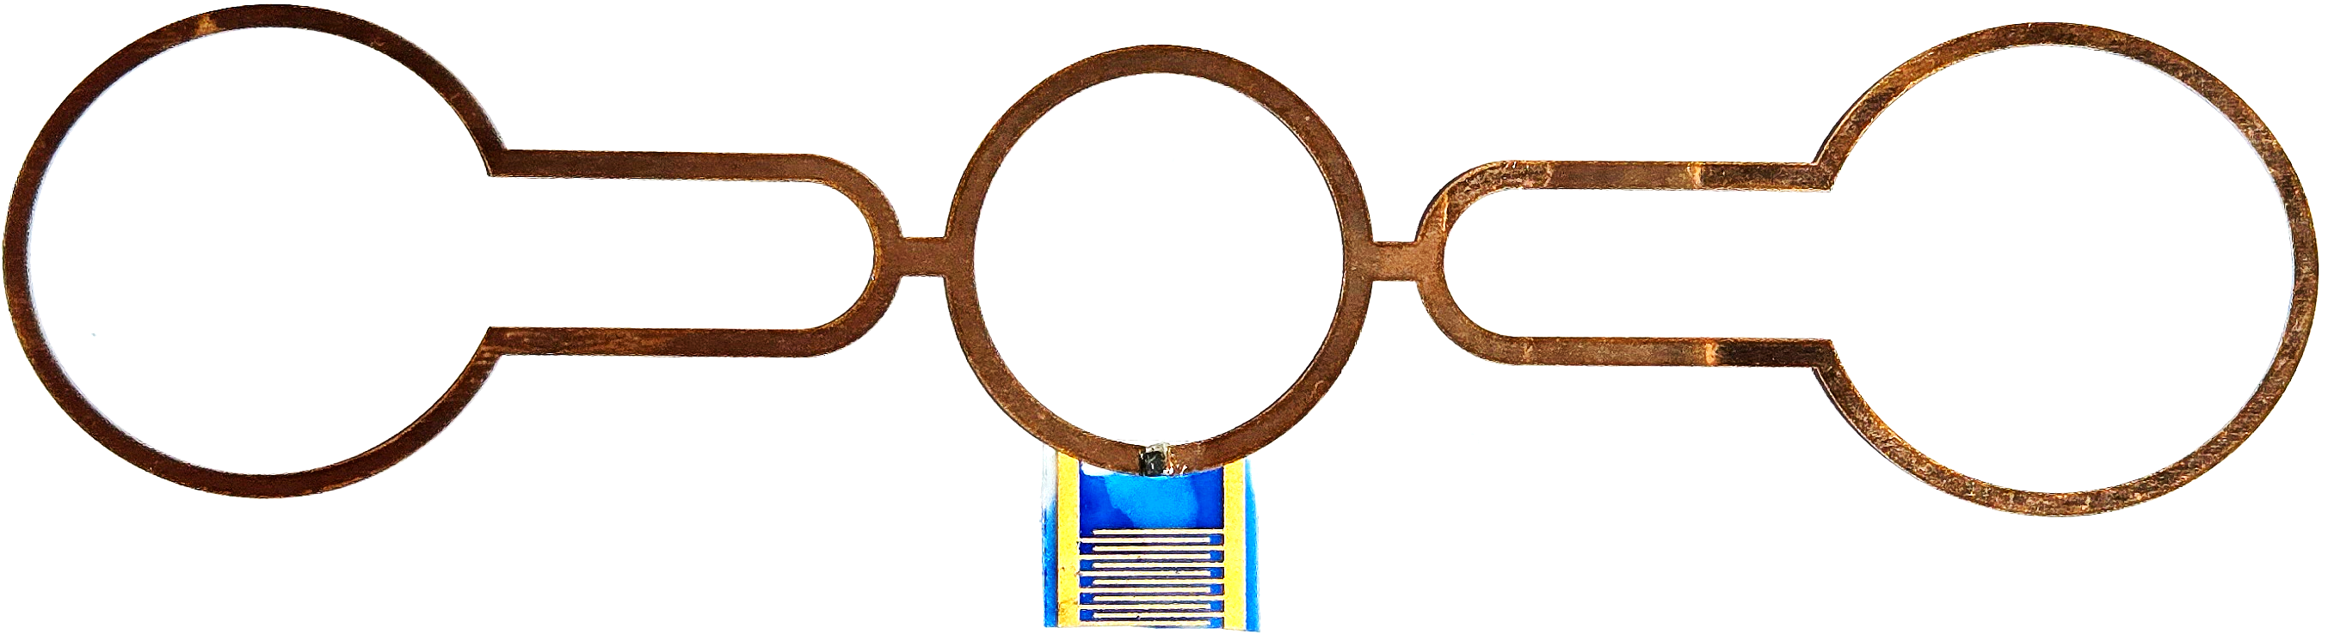
PhB/PVC
composite film
PET
Interdigitated capacitor
5mm
PhB/PVC
Solution
P-PhB/PVC Sensor

Slide 5
PhB/PVC
composite film
PET
Interdigitated capacitor
5mm
PhB/PVC
Solution
P-PhB/PVC Sensor

Slide 6
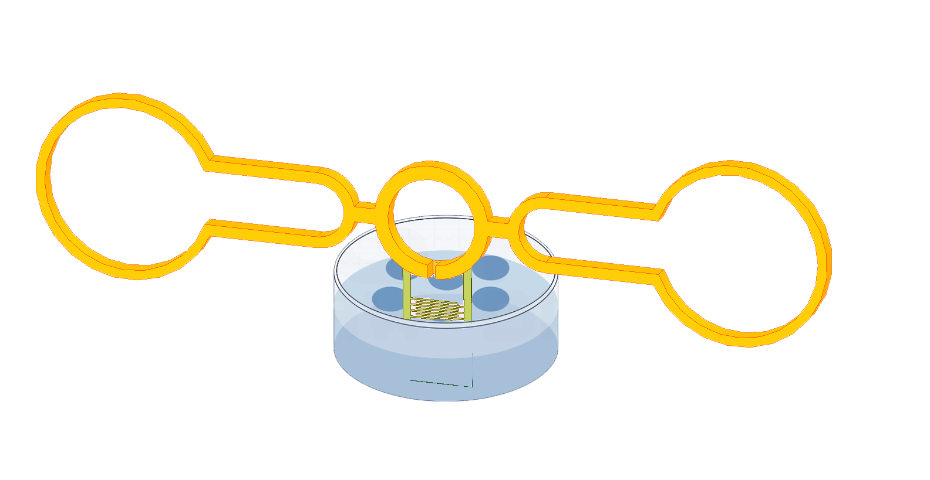
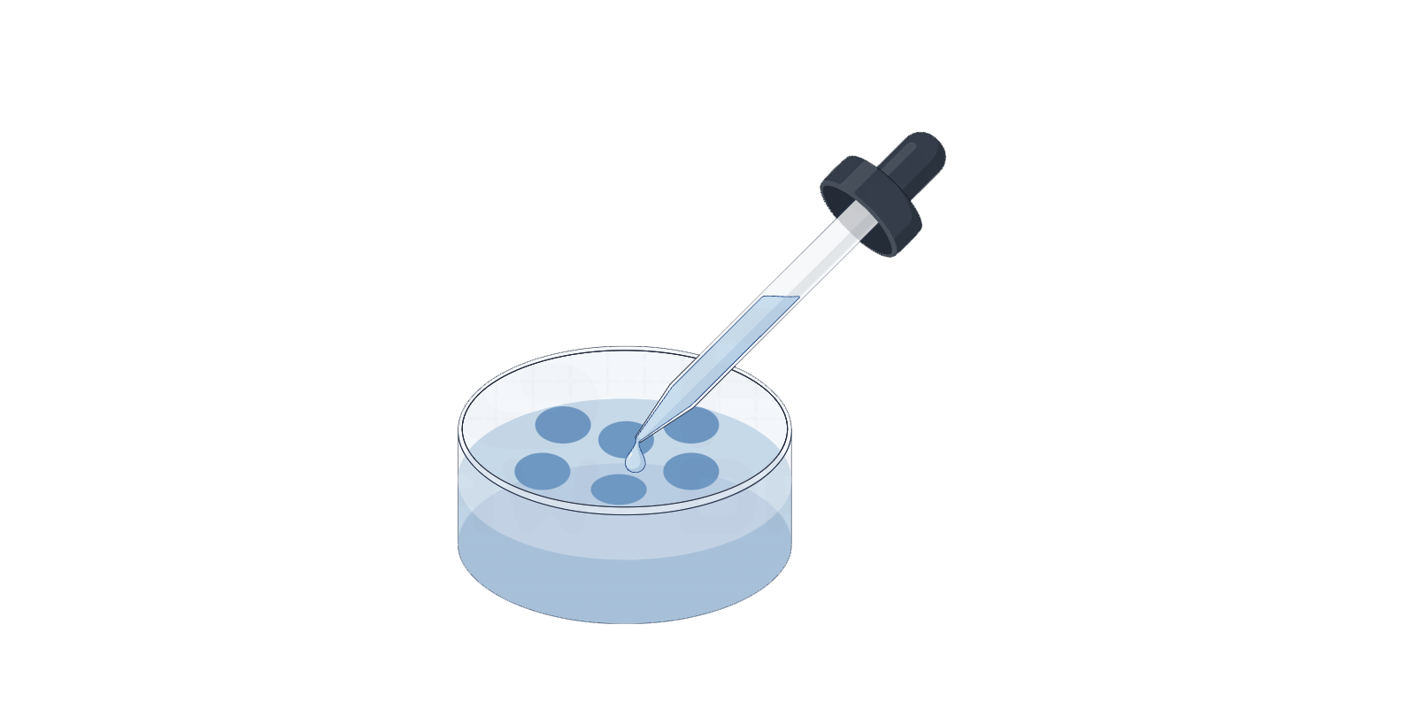
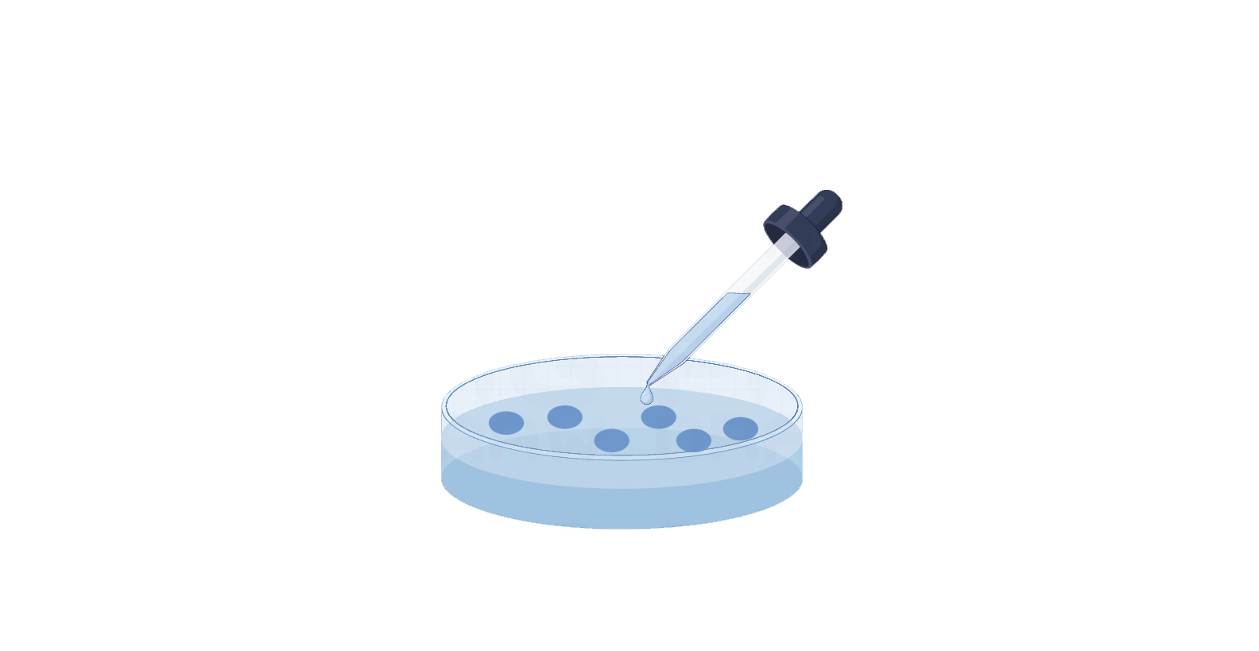
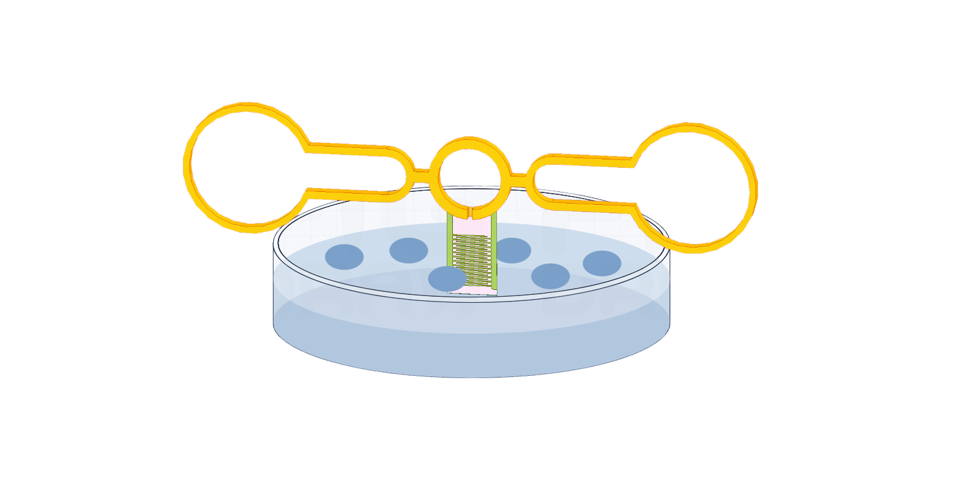
Bovine bone protein solution
Interdigitated Structure
Put the detect part into the solution

Slide 7
Bovine bone protein solution
Interdigitated Structure
Put the detect part into the solution

Slide 8
